Slide 1
Amplify
Donovan Moini, Ian Lizarda, Serena Zafiris

Slide 2

What is Amplify?
A community aux
Allows various ways for groups to play music from a group playlist
Round robin, shuffle, popularity, etc...
Both group and individual use

Slide 3


Why are we making Amplify?
Wanted to fix the “one aux controller” problem
Wanted to apply experience from Playroll last semester

Slide 4

What have we done so far?
Research
UI/UX design
Demo
We have a plan

Slide 5

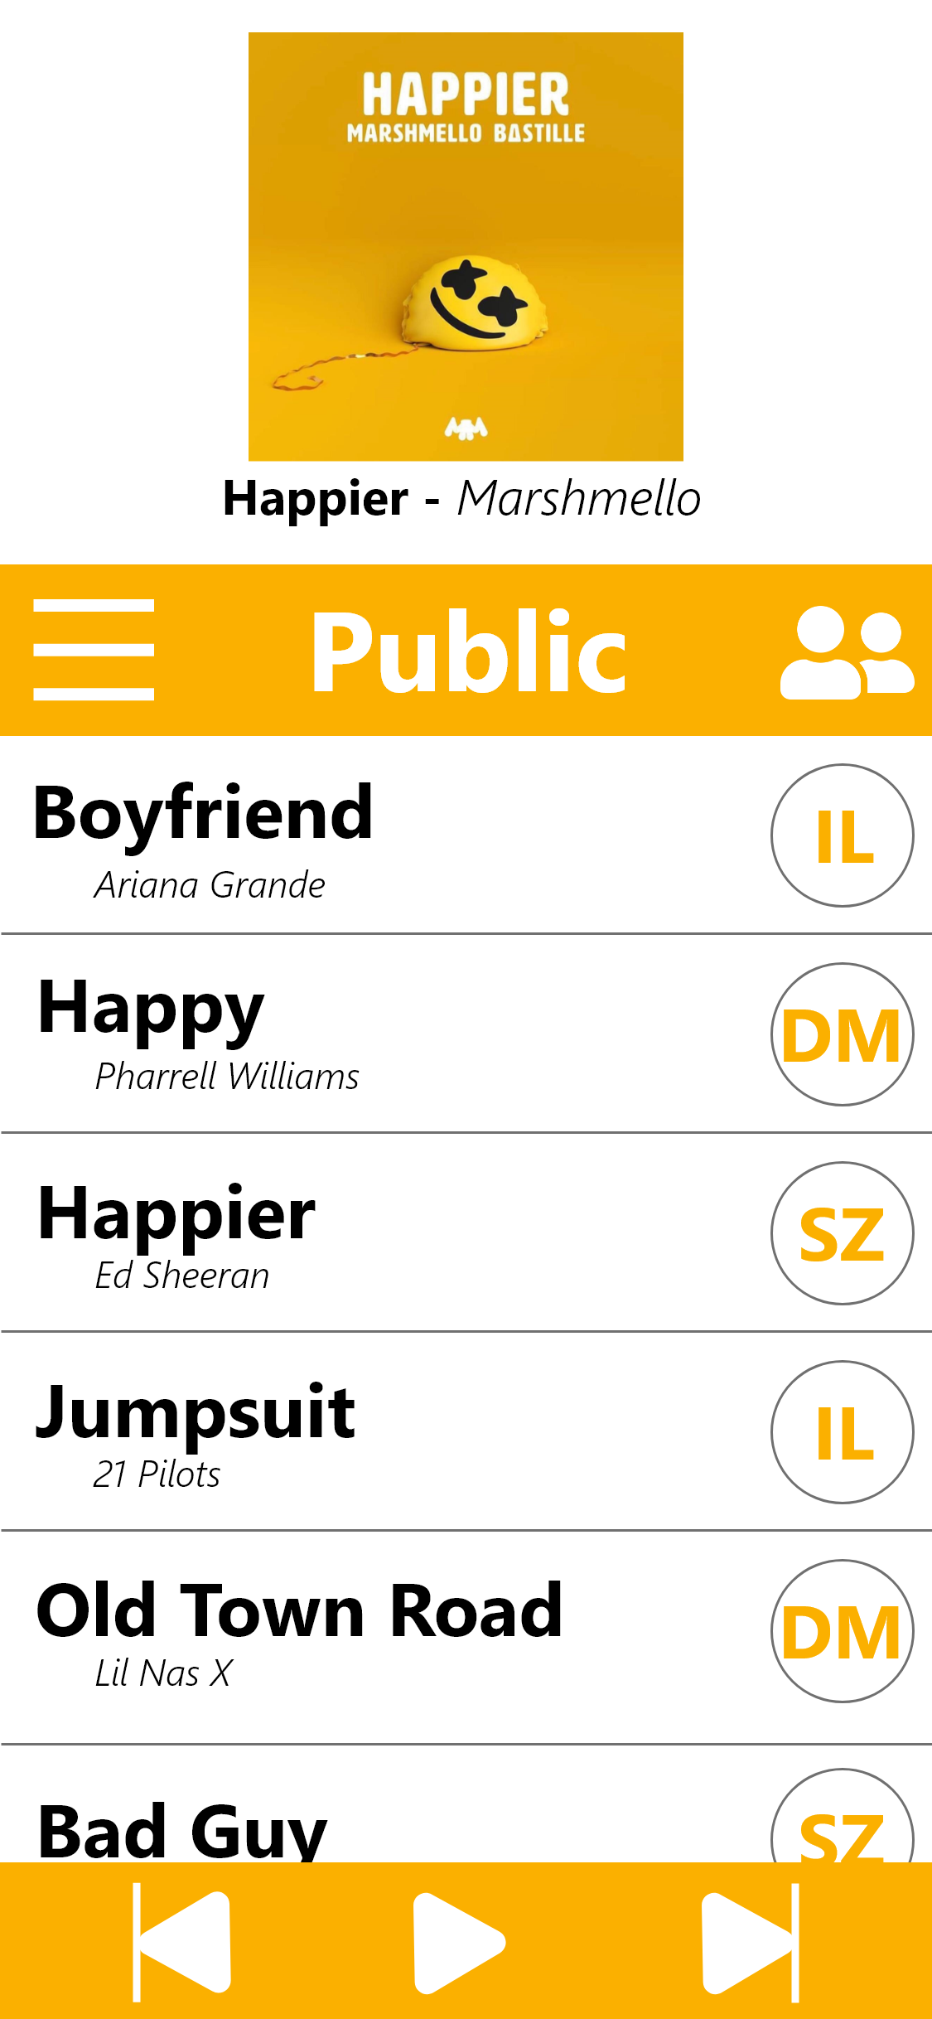

Slide 6
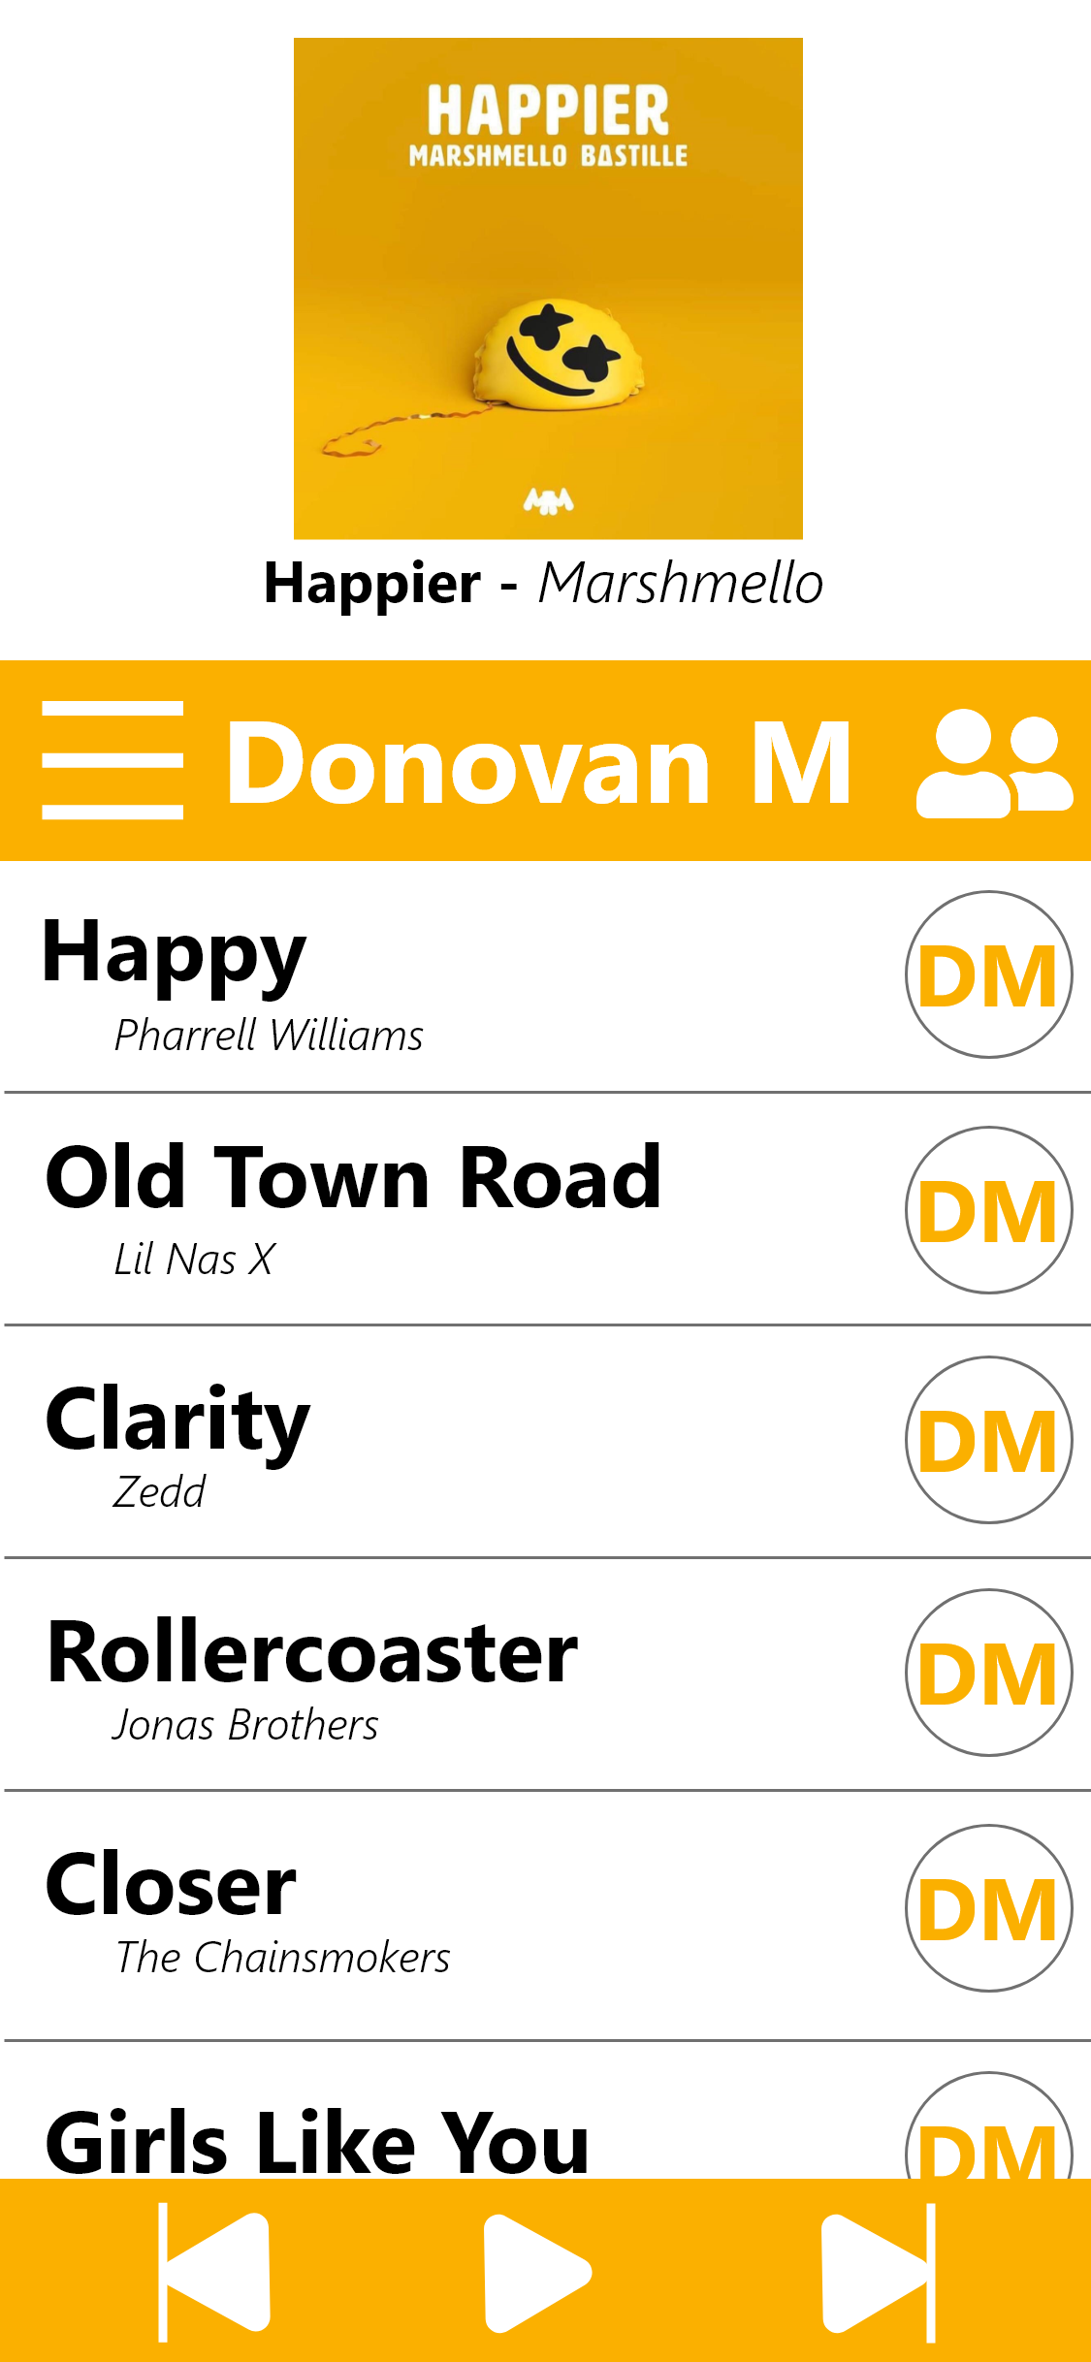
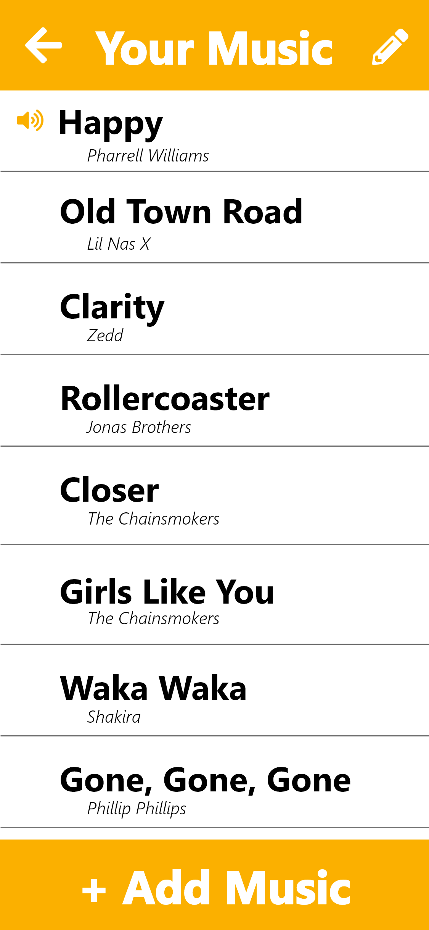

Slide 7
Demo!

Slide 8

What do we need?
Individuals interested in...
backend
full app development from start to finish
music and music-related applications
UX/UI design
iOS and Android development
JavaScript and React

Slide 9
Questions?

